Slide 1

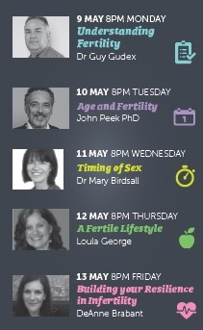
Webinar Series

Slide 2

Exists to support New Zealanders experiencing fertility problems, whether having difficulties becoming or staying pregnant
Information – Support – Advocacy
Fertility NZ is a registered Charity which has been dedicated to supporting people faced with fertility issues for over 25 years

Slide 3
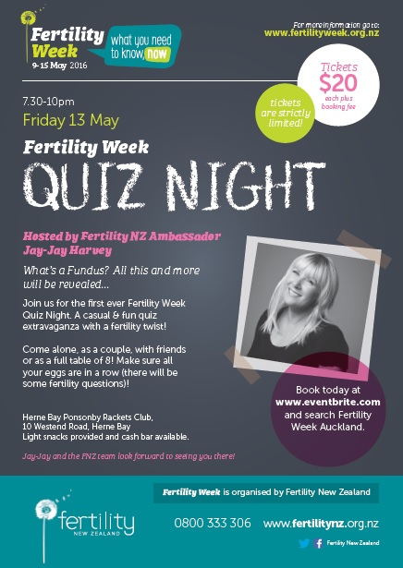

Slide 4
A Fertile Lifestyle
Loula George
Director, Mother-Well Holistic Health
Executive Committee Member, Fertility New Zealand

Slide 5
Preconception Health Care
The presence of all factors required for fertility and the creation of a healthy foetus and absence of all the factors detrimental to fertility and the formation of a healthy foetus
Simply aims for optimal general and reproductive health of both partners to ensure viable fertility and the health of the egg, sperm and ultimately the health of the child
Epigenetics
Fetus takes cues from the uterine environment to prepare itself physiologically for the rest of its life
The uterine environment conditions not only the fetus but the germ cells in the fetus, leading to effects in the 2nd generation

Slide 6
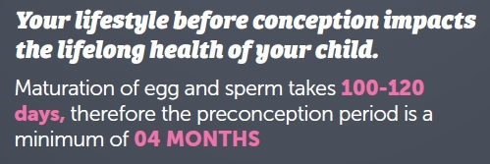
The Critical Four Months
Maturation of ova and spermatogenesis takes 100-120 days, therefore the preconception period is at least 4 months
The instant the egg and sperm combine, an irreversible genetic code is formed for future development of that baby
Health of the egg and sperm reflects health / toxicity of the environment in which they grow

Slide 7
Weight
Female and male fertility decreased by being overweight or underweight
Healthy body weight for fertility BMI 20-25
BMI under 18.5 = underweight
BMI over 30.0 = obese
Women with a BMI over 30 have a longer time to pregnancy than women who have a BMI between 20 and 25
Women with a BMI of over 32 are not eligible for publicly funded fertility treatment in NZ
Anderson, K., Norman, R.J. and Middleton, P. “Preconception lifestyle advice for people with subfertility.”Cochrane Database Syst Rev 14, no.4 (2010) CD008189

Slide 8
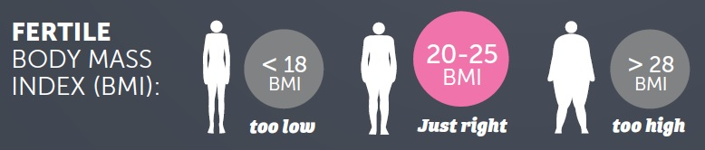
Weight
Overweight
After losing an average of 10.2 kg, 90% of obese women who did not ovulate, began ovulating
Underweight
Underweight before pregnancy and poor weight gain during pregnancy result in:
Anovulation
Increased chance of pre-term delivery
Low birth weight infants
Poor nutritional status -> affects health of pregnancy and baby
Clark, A.M., Thornley, B., Tomlinson, L., Galletley,C. and Norman, R.J. “Weight loss in obese infertile women results in improvement in reproductive outcome for all forms of fertility treatment” Human Reproduction 11. (1998):1502–1505.

Slide 9
Weight - Men
Obesity in men – increased risk of
Infertility
Impaired sperm quality and quantity
Decreased libido
Erectile dysfunction
Increased DNA damage
Hammoud, A., Meikle, A., Reis, L., Gisbon, M., Peterson, C. and Carrell, D. “Obesity and Male Infertility” Semin Reprod Med.30, no.6 (2012): 486-495

Slide 10
A fertile diet
Increase antioxidant rich foods – veges, fruit
Ensure adequate protein
Reduce saturated fats and trans fats, increase healthy fats
Reduce sugars and refined carbohydrates, increase whole grains
Avoid processed foods high in sugar, salt, additives, colourings, preservatives
Drink plenty of water – filtered where possible
Avoid coffee and caffeinated drinks
Eat organic where possible

Slide 11
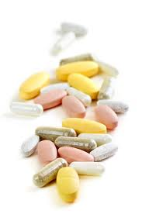
Supplements not a substitute for good healthy food
Women
  800mcg folic acid before conception (>4 weeks) & for first trimester of pregnancy
  150mcg iodine and throughout pregnancy / breastfeeding
  OR combined prenatal supplement with adequate folic acid and iodine
  Iron supplement if low iron levels
  Omega 3 oils
  Vitamin D
  Men
A Cochrane review including 34 studies, determined that men who use oral antioxidants had a significant increase in live birth rate.
Showell MG, Brown J, Yazdani A, Stankiewicz MT, Hart RJ: Antioxidants for male subfertility. Cochrane Database of Systematic Reviews (Online) 2011.
Notes:
The Blackmores pregnancy and breastfeeding gold supplement and the Blackmores Conceive Well supplement only supply 500mcg folic acid/day if taken in the recommended dosage. The iodine level is fine (150mcg).
Mention calcium (for women with low calcium, taking 1000-2000mg elemental calcium may reduce the risk of developing pre-eclampsia by around 50%), and vegans may need Vitamin B12 intramuscular injection of hydroxocobalamin 1000mcg/ampule before or during pregnancy.

Slide 12
Exercise
Not too little, not too much!
Regular moderate exercise (20-30 mins 5 x a week)
Physically active men who exercised at least three times a week for one hour typically scored higher in almost all sperm parameters in comparison to men who participated in more frequent and rigorous exercise
Excessive exercise can negatively affect fertility

Slide 13

Caffeine
Increased time to conception
Risk continues to rise with increased caffeine consumption
Association between high levels of caffeine consumption during pregnancy and an increased risk of stillbirth
May increase risk of miscarriage
Excessive caffeine can reduce and retard sperm quality
As little as 3 cups of coffee / day can have a seriously detrimental effect
2 cups / day or less! Be aware of energy drinks, some soft drinks, teas & chocolate which contain caffeine

Slide 14
Alcohol & fertility
Decreases fertility rates – levels as low as 1 drink per week has been associated with reduced conception rates
Increases risk of miscarriage
Extreme levels = dangerous to unborn child
Effects at lower levels uncertain
Most vulnerable time for foetus is in first weeks of pregnancy (often undetected)
UNSW Australia. National Perinatal Epidemiology and Statistics Unit – Assisted Reproductive Technology in Australia and NZ 2011. http://www.npesu.unsw.edu.au/surveillance/assisted-reproductive-technology-australia-new-zealand-2011

Slide 15
Alcohol
Risks for women
Anovulation
Luteal phase dysfunction
Delayed conception
Abnormal blastocyst formation
Increased risk of spontaneous abortion and foetal death
Impact on children’s cognitive and socio-emotional development
Risks for men
Testicular atrophy
Decreased libido
Decreased semen volume
Decreased sperm numbers and quality
Woodruff, T.J., Carlson, A., Schwartz, M.P.H. and Giudice, L.C. “Proceedings of the Summit on Environmental Challenges to Reproductive health and Fertility” Fertility and Sterility 89, No.2 (2008):281-300

Slide 16
Other drugs
Marijuana
Men – reduce testosterone, spermatogenesis, sperm motility
Women – impacts hormonal regulation and affects egg and embryo movement throughout oviducts
Negatively impacts placental and fetal development
Other drugs
Cocaine and heroin interfere with healthy sperm. The effect of synthetic drugs such as methamphetamine (‘P’) is less known
Prescription medicines
May impact fertility – check with doctor

Slide 17
Smoking
Cigarette smoke contains over 4000 chemicals. Associated with
lower fertility rates
Increased ectopic pregnancy risk
adverse reproductive outcomes
higher risk of IVF failure
Women
Risk of ovarian problems, ovarian reserve issues and hormonal problems
Men
Decrease in total semen volume, sperm count, motility, morphology, fertilising capacity, sperm DNA integrity, testosterone and increase in erectile dysfunction

Slide 18
Environmental Toxicity
Exposure to environmental contaminants (synthetic chemicals, heavy metals), during critical periods of development (before conception and during pregnancy), have potential effects on all aspects of future reproductive health (1)
100,000 synthetic chemicals are available in the market
1500 new chemicals will be produced this year
Of 80,000 chemicals used in this country only 200 have been tested for safety.
Be aware of Radiation
(1) Woodruff, T.J., Carlson, A., Schwartz, M.P.H. and Giudice, L.C. “Proceedings of the Summit on Environmental Challenges to Reproductive health and Fertility” Fertility and Sterility 89, No.2 (2008):281-300

Slide 19
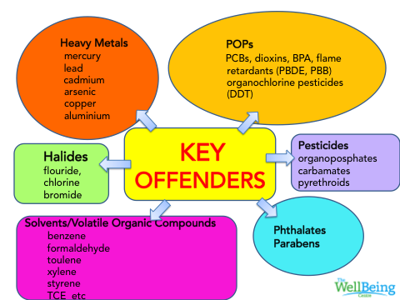
Environmental Toxicity
Notes:
POPs – persist in envt and bio accumulate. Phthalates – used in solvents, lubricants, stabilisers, plasticisers – make plastics flexible. Found in toys, medical equipment, blood storage bags, cosmetics, perfumes, food packaging

Slide 20
Endocrine disruptors
Pesticides, insecticides, plastics, cosmetics
Mimic natural hormones
Impede normal hormonal activity
Various damaging effects on reproductive health
Sharma, R., Biedenham, K.R., Fedor, J. and Agarwa,l. “Lifestyle factors and reproductive health: Taking control of your fertility” Reprod Biol Endocrinol. 11( 2013):66

Slide 21
Stress
Infertility = major stress
Stress undermines effective functioning of the immune system, adrenals, digestion and hormonal balance all of which contribute to the fertile state
Study of 373 women between 18 and 40 years linked stress to infertility
Stressed women half as likely to conceive in 12 months of trying
29% less likely to conceive each month
Simple remedy of light exercise or yoga could improve chances
Journal of Human Reproduction 2014

Slide 22

A fertile lifestyle, in summary
Lifestyle changes 4 months prior to conception – improve chance of conception and lifelong health of child
BMI 20-25
Healthy diet with essential nutrients
Antioxidants for men!
Regular, moderate exercise
Avoid or limit caffeine – 2 cups / day maximum!
Avoid or limit alcohol
Avoid recreational drugs and be aware of prescription drugs
Don’t smoke!
Be aware of environmental factors impacting fertility – such as cosmetics, cleaners, poisons, radiation
Be aware of stress. Prioritise self-care
Journal of Human Reproduction 2014

Slide 23
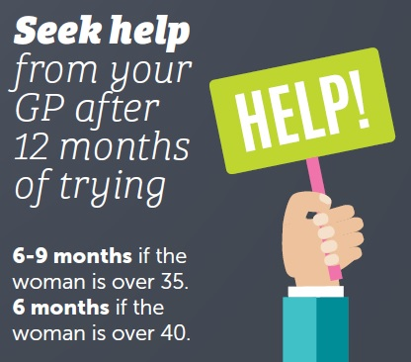
When to seek help
When there is a known medical condition affecting fertility, or…

Slide 24
Any questions?

Slide 25
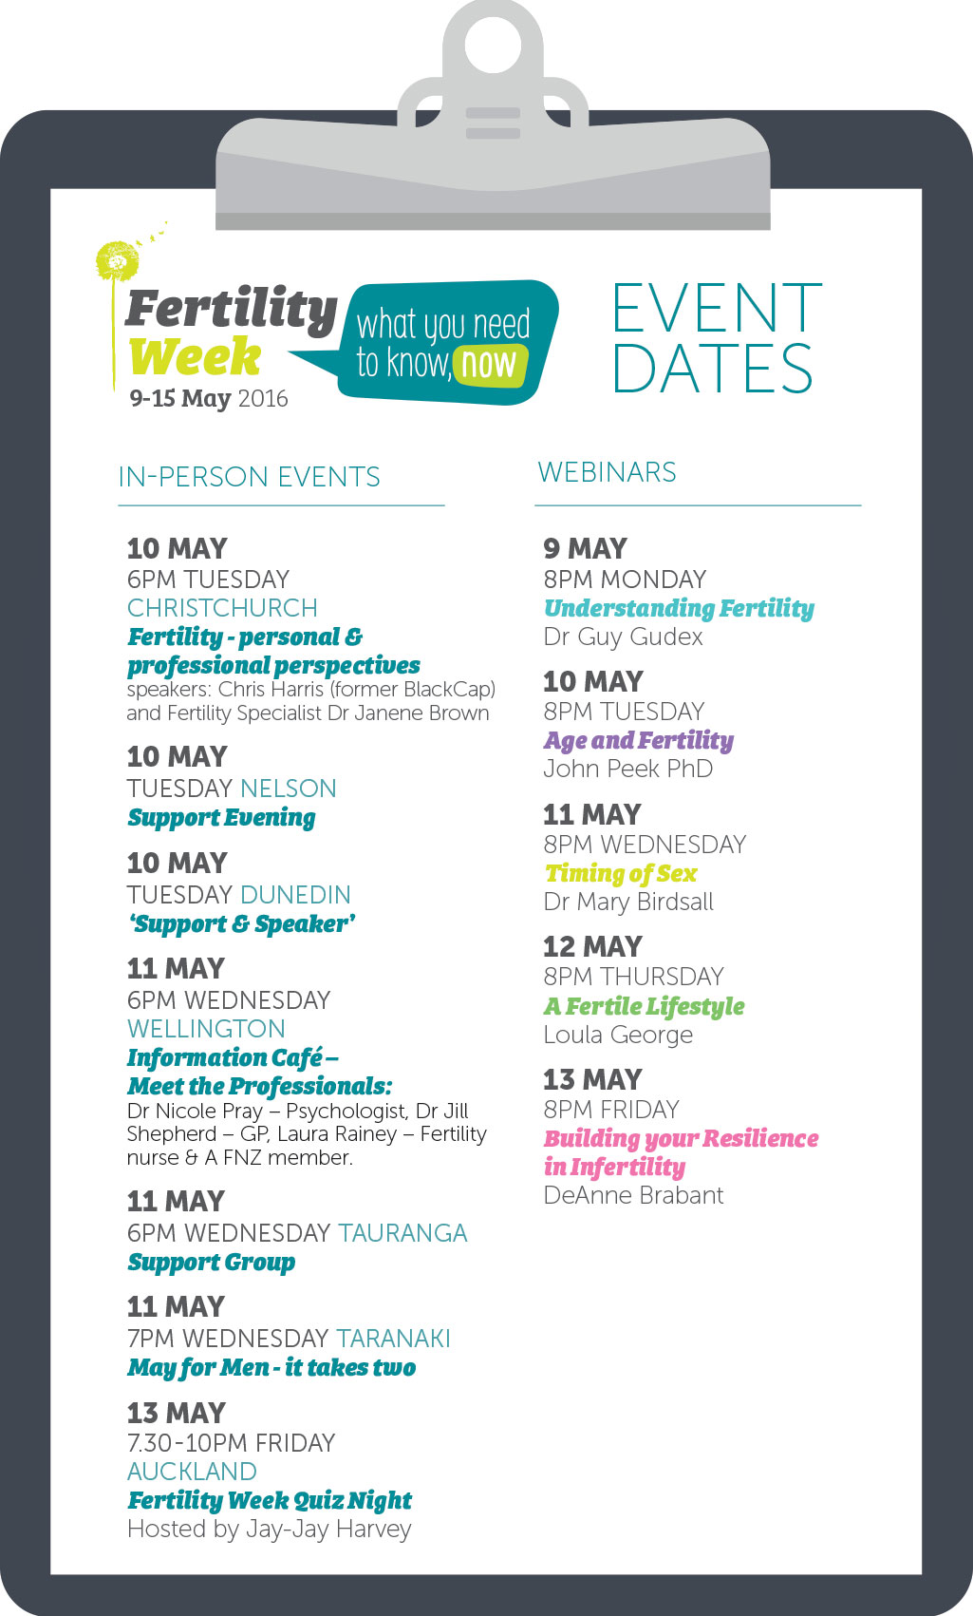

Thank you!

